Slide 1
Process Synchronization
Prepared By
Dr. Teena Narang
Chitkara University Institute of Engineering and Technology,
Chitkara University, Punjab

Slide 2
Content
Background
The Critical-Section Problem
Peterson’s Solution
Synchronization Hardware
Mutex Locks

Slide 3
Background
Processes can execute concurrently
May be interrupted at any time, partially completing execution
Concurrent access to shared data may result in data inconsistency
Maintaining data consistency requires mechanisms to ensure the orderly execution of cooperating processes
Illustration of the problem:
Suppose that we wanted to provide a solution to the consumer-producer problem that fills all the buffers. We can do so by having an integer counter that keeps track of the number of full buffers. Initially, counter is set to 0. It is incremented by the producer after it produces a new buffer and is decremented by the consumer after it consumes a buffer.

Slide 4
Producer
while (true) { /* produce an item in next produced */
while (counter == BUFFER_SIZE) ;
/* do nothing */
buffer[in] = next_produced;
in = (in + 1) % BUFFER_SIZE;
counter++;
}

Slide 5
Consumer
while (true) {
while (counter == 0)
; /* do nothing */
next_consumed = buffer[out];
out = (out + 1) % BUFFER_SIZE;
counter--;
/* consume the item in next consumed */
}

Slide 6
Race Condition
counter++ could be implemented as register1 = counter register1 = register1 + 1 counter = register1
counter-- could be implemented as register2 = counter register2 = register2 - 1 counter = register2
Consider this execution interleaving with “count = 5” initially:
S0: producer execute register1 = counter {register1 = 5} S1: producer execute register1 = register1 + 1 {register1 = 6} S2: consumer execute register2 = counter {register2 = 5} S3: consumer execute register2 = register2 – 1 {register2 = 4} S4: producer execute counter = register1 {counter = 6 } S5: consumer execute counter = register2 {counter = 4}

Slide 7
Critical Section Problem
Consider system of n processes {p₀, p₁, … p_{n-1}}
Each process has critical section segment of code
Process may be changing common variables, updating table, writing file, etc
When one process in critical section, no other may be in its critical section
Critical section problem is to design protocol to solve this
Each process must ask permission to enter critical section in entry section, may follow critical section with exit section, then remainder section

Slide 8
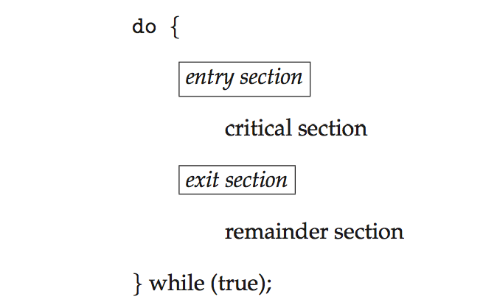
Critical Section
General structure of process P_{i}

Slide 9
Algorithm for Process P_{i}
do {
while (turn == j);
critical section
turn = j;
remainder section
} while (true);

Slide 10
Solution to Critical-Section Problem
1. Mutual Exclusion - If process P_{i} is executing in its critical section, then no other processes can be executing in their critical sections
2. Progress - If no process is executing in its critical section and there exist some processes that wish to enter their critical section, then the selection of the processes that will enter the critical section next cannot be postponed indefinitely
3. Bounded Waiting - A bound must exist on the number of times that other processes are allowed to enter their critical sections after a process has made a request to enter its critical section and before that request is granted
Assume that each process executes at a nonzero speed
No assumption concerning relative speed of the n processes

Slide 11
Critical-Section Handling in OS
Two approaches depending on if kernel is preemptive or non- preemptive
Preemptive – allows preemption of process when running in kernel mode
Non-preemptive – runs until exits kernel mode, blocks, or voluntarily yields CPU

Slide 12
Classic solution to Critical Section Problem
Two Process Solution using turn variable (Algo 1)
do
{
while ( turn != i);
CS
turn = j;
RS
}while (1)
It Leads to deadlock and doesn't retain information about the status of each process. It remembers only the process allowed to enter the critical section.

Slide 13
Classic solution to Critical Section Problem
Algo 1 Leads to deadlock and doesn't retain information about the status of each process. It remembers only the process allowed to enter the critical section.
Algo 2 leads to no progress because both process enter waiting state for indefinite time.
Two Process Solution using Boolean array
Boolean flag[2];
flag[i] = true;
while ( flag[j]);
CS
flag[i] = false;
RS
}while (1)

Slide 14
Peterson’s Solution
Good algorithmic description of solving the problem
Two process solution
Assume that the load and store machine-language instructions are atomic; that is, cannot be interrupted
The two processes share two variables:
int turn;
Boolean flag[2]
The variable turn indicates whose turn it is to enter the critical section
The flag array is used to indicate if a process is ready to enter the critical section. flag[i] = true implies that process P_{i} is ready!

Slide 15
Algorithm for Process P_{i}
do {
flag[i] = true;
turn = j;
while (flag[j] && turn = = j);
critical section
flag[i] = false;
remainder section
} while (true);

Slide 16
Peterson’s Solution (Cont.)
Provable that the three CS requirement are met:
1. Mutual exclusion is preserved
P_{i} enters CS only if:
either flag[j] = false or turn = i
2. Progress requirement is satisfied
3. Bounded-waiting requirement is met

Slide 17
Synchronization Hardware
Many systems provide hardware support for implementing the critical section code.
All solutions below based on idea of locking
Protecting critical regions via locks
Uniprocessors – could disable interrupts
Currently running code would execute without preemption
Generally too inefficient on multiprocessor systems
Operating systems using this not broadly scalable
Modern machines provide special atomic hardware instructions
Atomic = non-interruptible
Either test memory word and set value
Or swap contents of two memory words

Slide 18
Solution to Critical-section Problem Using Locks
do {
acquire lock
critical section
release lock
remainder section
} while (TRUE);

Slide 19
test_and_set Instruction
Definition:
boolean test_and_set (boolean *target)
{
boolean rv = *target;
*target = TRUE;
return rv:
}
Executed atomically
Returns the original value of passed parameter
Set the new value of passed parameter to “TRUE”.

Slide 20
Solution using test_and_set()
Shared Boolean variable lock, initialized to FALSE
Solution:
do { while (test_and_set(&lock))
; /* do nothing */
/* critical section */
lock = false;
/* remainder section */
} while (true);

Slide 21
compare_and_swap Instruction
Definition:
int compare _and_swap(int *value, int expected, int new_value) {
int temp = *value;
if (*value == expected)
*value = new_value;
return temp;
}
Executed atomically
Returns the original value of passed parameter “value”
Set the variable “value” the value of the passed parameter “new_value” but only if “value” ==“expected”. That is, the swap takes place only under this condition.

Slide 22
Solution using compare_and_swap
Shared integer “lock” initialized to 0;
Solution:
do{ while (compare_and_swap(&lock, 0, 1) != 0)
; /* do nothing */
/* critical section */
lock = 0;
/* remainder section */
} while (true);

Slide 23
Bounded-waiting Mutual Exclusion with test_and_set
do { waiting[i] = true; key = true; while (waiting[i] && key)
key = test_and_set(&lock);
waiting[i] = false;
/* critical section */
j = (i + 1) % n;
while ((j != i) && !waiting[j])
j = (j + 1) % n;
if (j == i)
lock = false;
else
waiting[j] = false;
/* remainder section */
} while (true);

Slide 24
Mutex Locks
Previous solutions are complicated and generally inaccessible to application programmers
OS designers build software tools to solve critical section problem
Simplest is mutex lock
Protect a critical section by first acquire() a lock then release() the lock
Boolean variable indicating if lock is available or not
Calls to acquire() and release() must be atomic
Usually implemented via hardware atomic instructions
But this solution requires busy waiting
This lock therefore called a spinlock

Slide 25
acquire() and release()
acquire() { while (!available)
; /* busy wait */
available = false;
}
release() {
available = true;
}
do {
acquire lock
critical section
release lock
remainder section
} while (true);

